Slide 1
Design Patterns
Vivek Gohil

Slide 2
SOLID Principles
Single Responsibility Principle
Open Closed Principle
Liskov Substitution Principle
Interface Segregation Principle
Dependency Inversion Principle

Slide 3
Single Responsibility Principle
There should never be more than one reason for a class to change
The class provides a very focused functionality.
It addresses a specific concern of our desired functionality.

Slide 4
Open Closed Principle
Software entities(Class , Modules, Methods) should be open for extension but closed for modification.
Open for extension : Extend existing behaviour(Create new class which derived from base and override methods).
Closed for modification : Existing code remains unchanged(Avoid modification in base classes).

Slide 5
Liskov Substitution Principle
Object of a superclass shall be replaceable with objects of its subclasses without breaking the application.

Slide 6
Interface Segregation Principle
Clients should not be forced to depend upon interfaces that they do not use.
This is also known as interface pollutions(Large and unrelated methods)
Classes have empty method implementations
Method implementations return null or default/dummy values.
Write Highly Cohesive Interfaces.

Slide 7
Dependency Inversion Principle
Part 1 : High level modules should not depend upon low level modules. Both should depend upon abstractions.
Part 2 : Abstractions should not depend upon details. Details should depend upon abstractions.

Slide 8
Design Pattern
Creational Design Pattern
Creational patterns deal with the process of creation of objects of classes.
Structural Design Pattern
Structural patterns deal with how classes and objects are arranged or composed.
Behavioural Design Pattern
Behavioural Design Patterns describe how classes and objects interact and communicate with each other.

Slide 9
Creational Design Pattern
Builder
Simple Factory
Factory Method
Prototype
Singleton
Abstract Factory
Object Pool

Slide 10
Builder Pattern
What problem builder design pattern solves?
Class constructor requires a lots of information
Having a lots of arguments in constructor parameter is not a good practice.
It also creates the confusion if the constructor parameter has same datatypes.
Sometimes constructor also require some other class object as parameter.
//Product instances are immutable
class Product {
public Proudct(int weight, double price, int shipVolume, int shipCode) {
// variable initialization
}
// other code
}

Slide 11
Builder Pattern
Builder pattern make it easy to use such constructors so that we can create objects of this class.
It also help us avoid writing such constructors in first place and still have our objects immutable.

Slide 12
Builder Pattern
What is a Builder?
We have a complex process to construct an object involving multiple steps, then builder design pattern can help us.
In builder we remove the logic related to object construction from “Client” code and abstract it in separate classes

Slide 13
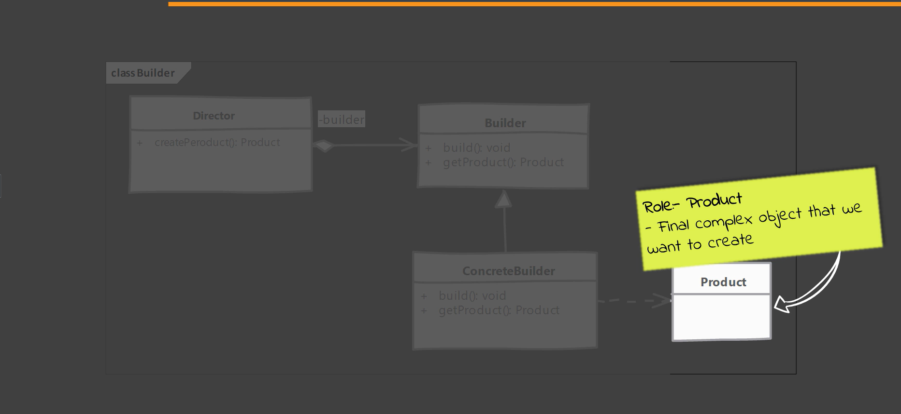
UML

Slide 14
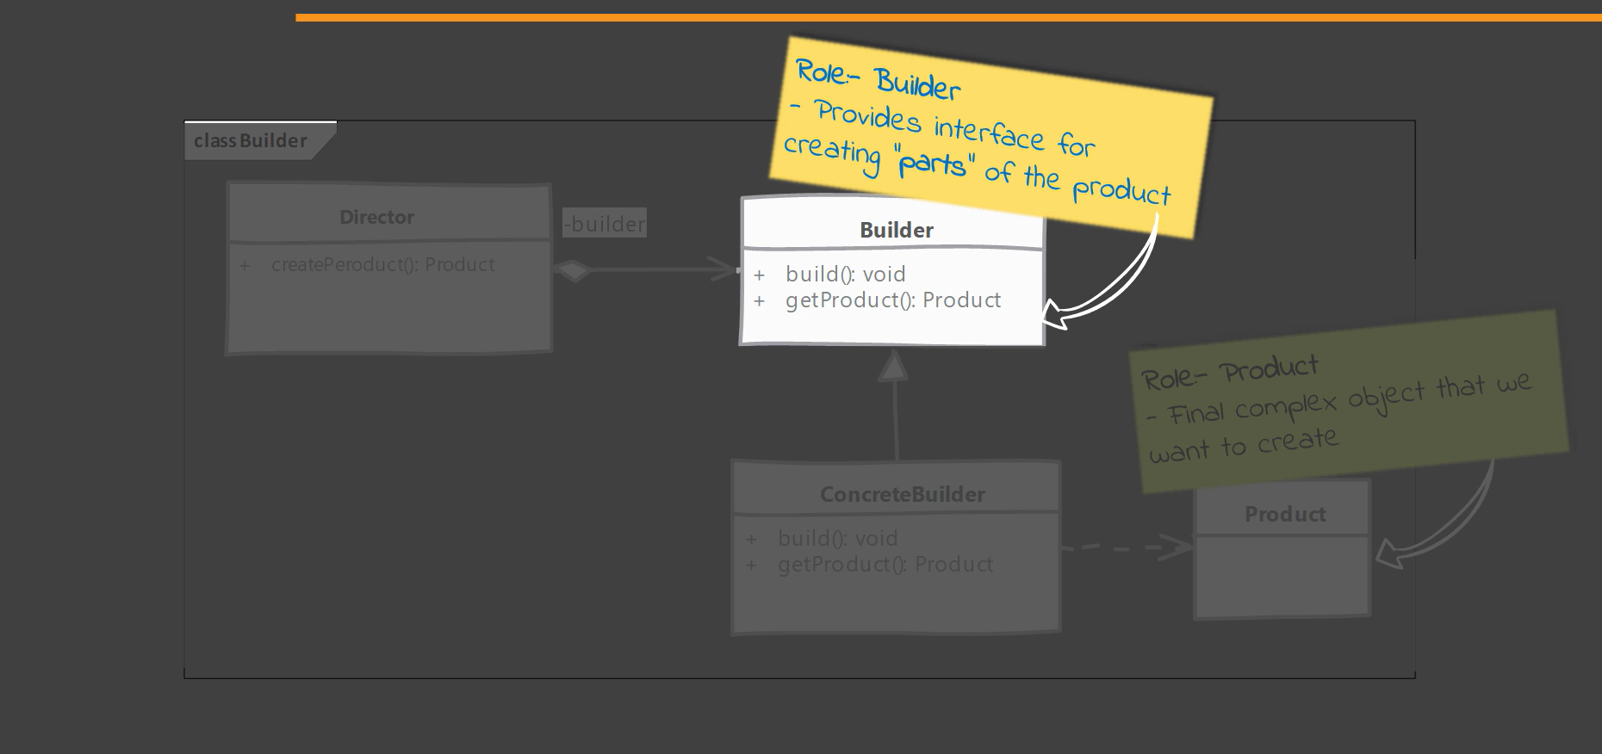
UML

Slide 15
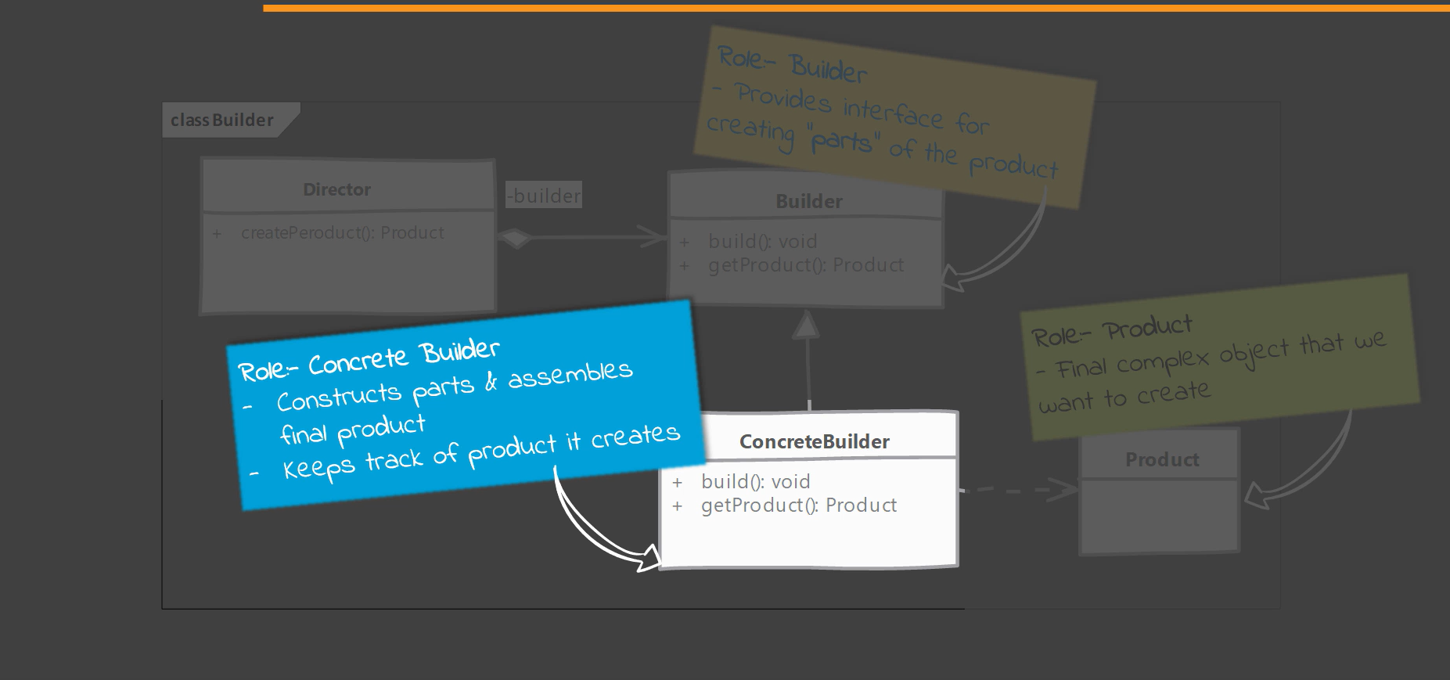
UML

Slide 16
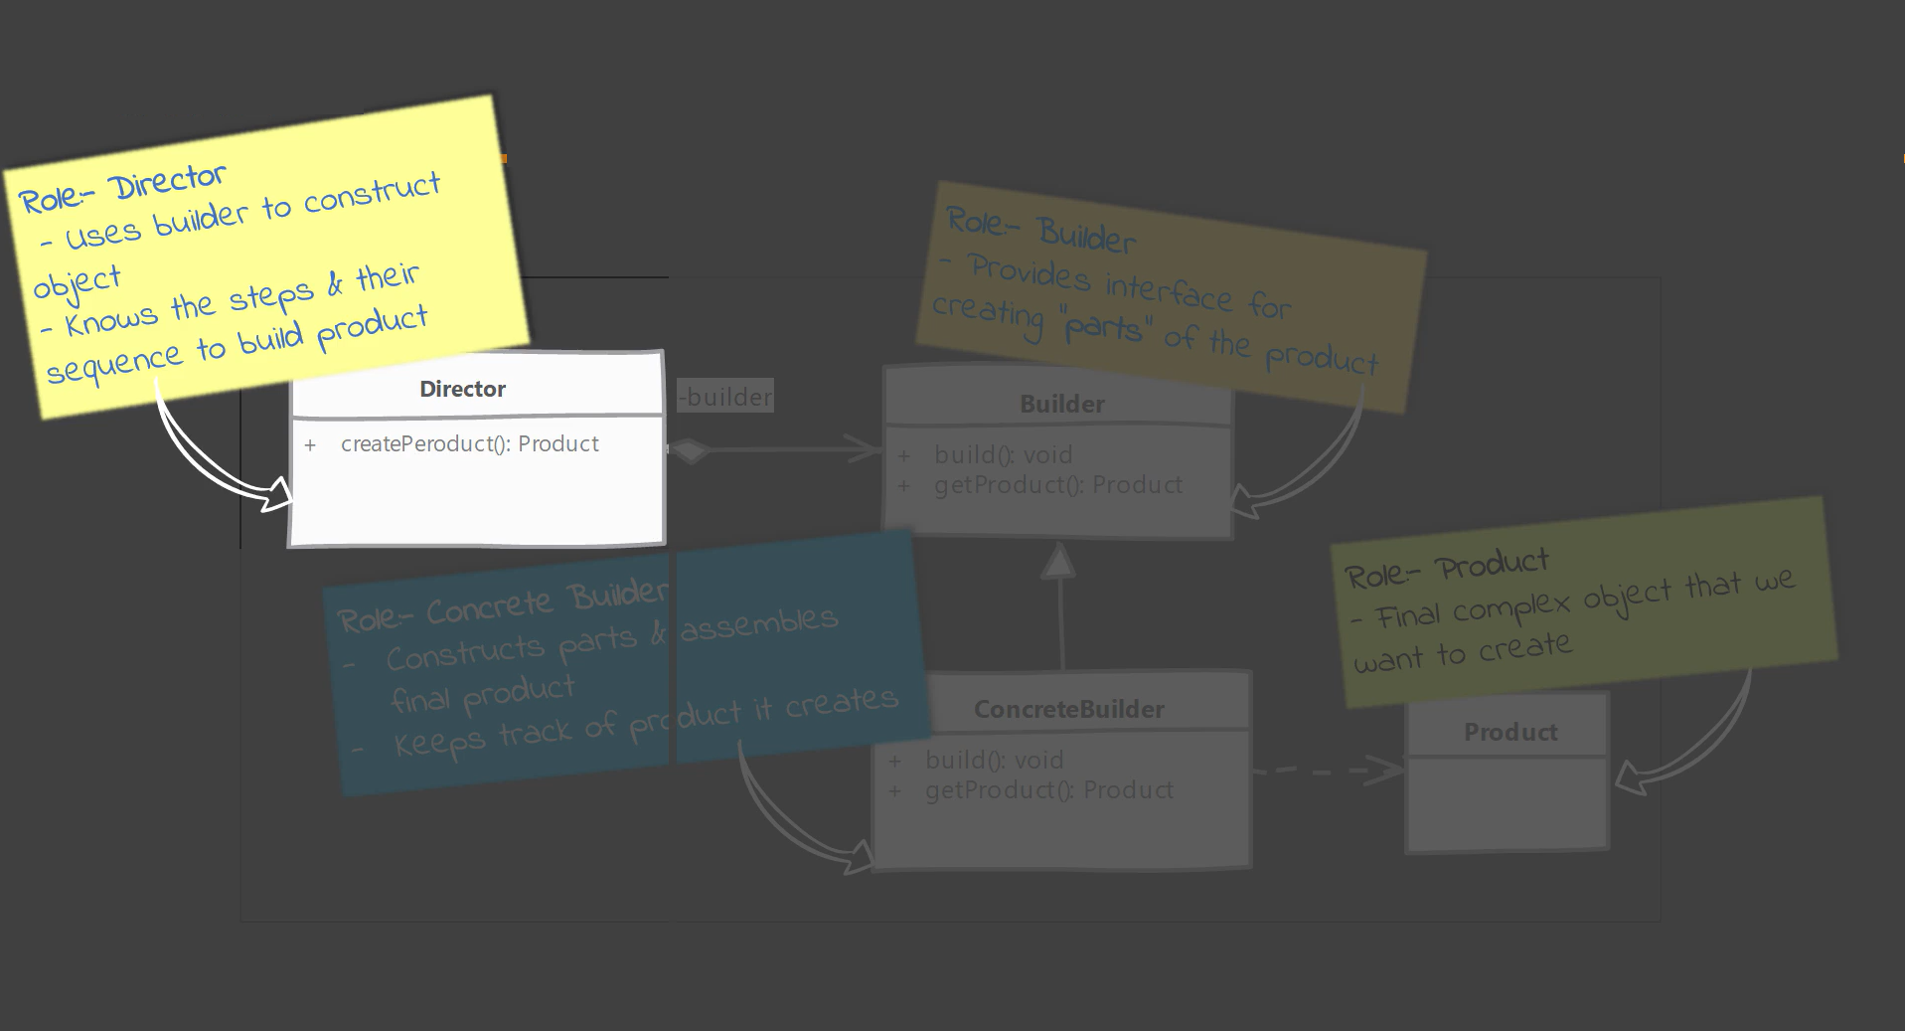
UML

Slide 17
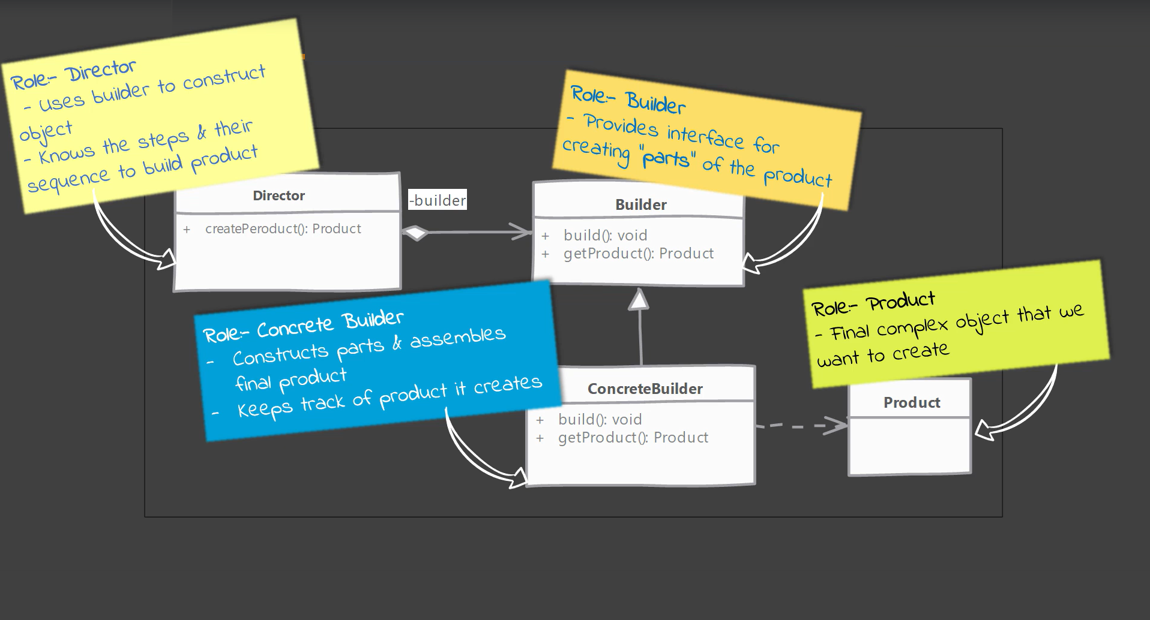
UML

Slide 18
Implement a Builder
We start by creating a builder
Identify the parts of the product and provide methods to create those parts
It should provide a method to assemble or build the product/object
It must provide a way/method to get fully built object out. Optionally builder can keep reference to an product it has built the same can be returned again in future.
A director can be a separate class or client can play the role of director.

Slide 19
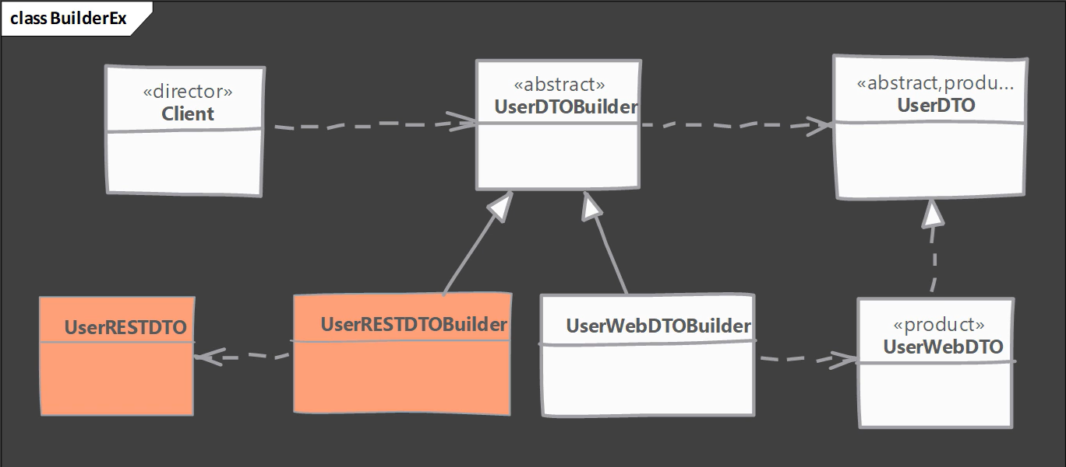
Example UML

Slide 20
Simple Factory
What problem simply factory solves?
Multiple types can be instantiated, and the choice is based on simple criteria
if(key.equalsIgnoreCase("pudding")) {
// create pudding object
}
else if (key.equalsIgnoreCase("cake")) {
// create cake object
}

Slide 21
Simple Factory
What is a Simple Factory?
Here we simply move the instantiation logic to a separate class and most commonly to a static method of this class.
Some do not consider simple factory to be a “design pattern” as its simply a method that encapsulates the object instantiation.
Nothing complex goes on in that method.
We are studying simple factory as it is often confused with “factory method” pattern
Typically, we want to do this if we have more than one option when instantiating object and a simple logic is used to choose correct class.

Slide 22
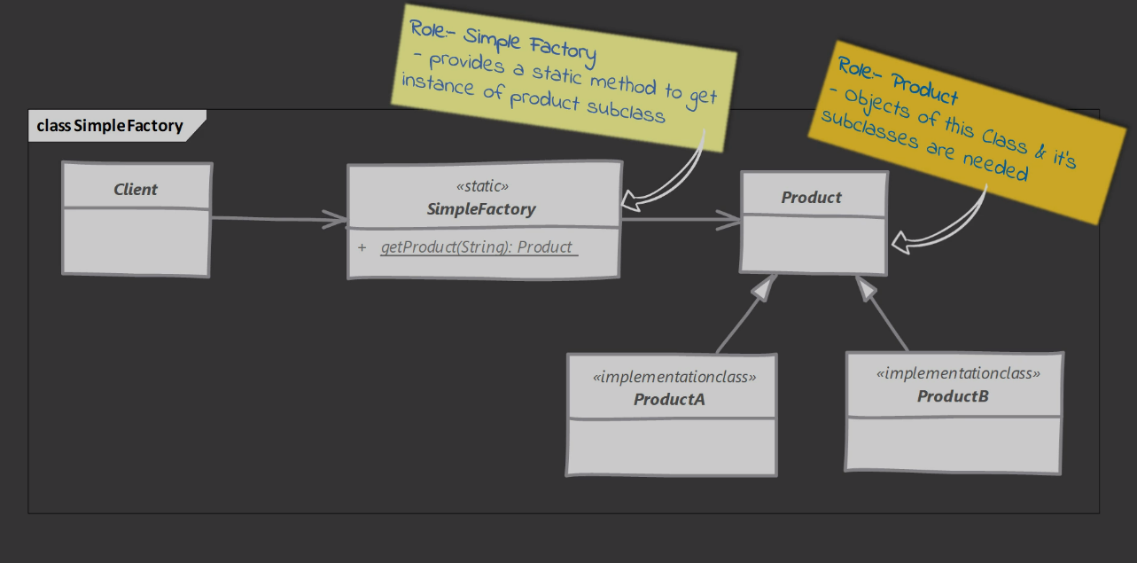
Simple Factory

Slide 23
Simple Factory
Implement a Simple Factory
We start by creating a separate class for our simple factory
Add method with returns desired object instance.
This method is typically static and will accept some argument to decide which class to instantiate.
You can also provide additional arguments which will be used to instantiate objects.

Slide 24
Simple Factory
Implementation Considerations
Simple factory can be just a method in existing class. Adding a separate class however allows other parts of your code to use simple factory more easily.
Simple factory itself doesn’t need any state tracking so its best to keep this as a static method.
Simple factory will in turn may use other design pattern like builder to construct objects.
In case you want o specialized your simple factory in sub classes , you need factory method design pattern instead.

Slide 25
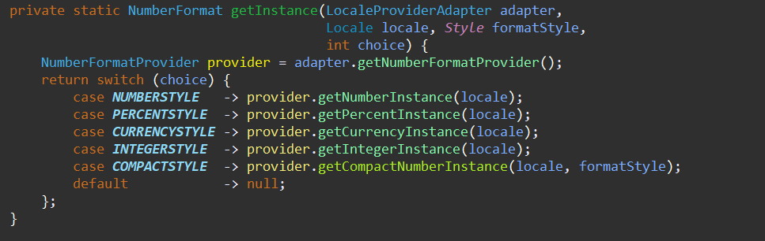
Simple Factory
The java.text.NumberFormat class has getInstance method, which is an example of simple factory.

Slide 26
Simple Factory
Simple Factory
Factory Method
We simply move our instantiation logic away from client code. Typically, in a static method.
Simple factory knows about all classes whose object it can create.
Factory method is more useful when you want to delegate object creation to subclasses.
In Factory method we don’t know in advance about all products subclasses.

Slide 27
Simple Factory
Pitfalls
The criteria used by simple factory to decide which object to instantiate can get more convoluted/complex over time.
If you find yourself in such situation then use factory method design pattern.

Slide 28
Simple Factory
Quiz
Select correct/true statements regarding the simple factory pattern from following statements.
A simple factory assembles objects one part at a time.
A simple factory allows to maintain single instance of a class in entire application.
A simple factory can instantiate an object based on simple criteria.
A simple factory saves JVM memory by pooling the objects.
Select the benefits of implementing simple factory in a separate class.
It allows simple factory to use inheritance and specialized object creation.
It allows to reuses the simple factory by other classes without importing unrelated classes.

Slide 29
Factory Method
What is a factory method?
We want to move the object creation logic from our code to separate class.
We use this pattern when we do not know in advance which class we may need to instantiate beforehand.
Also to allow new classes to be added to system and handle their creation without affecting client code.
We let subclasses decide which object to instantiate by overriding the factory method.

Slide 30
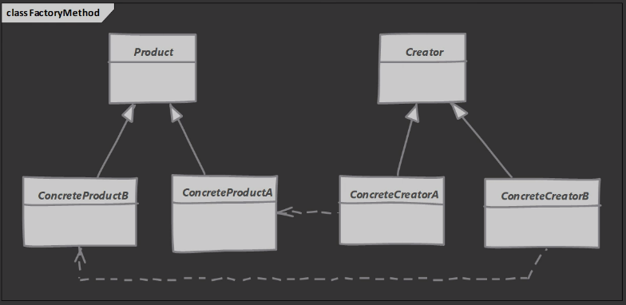
UML

Slide 31
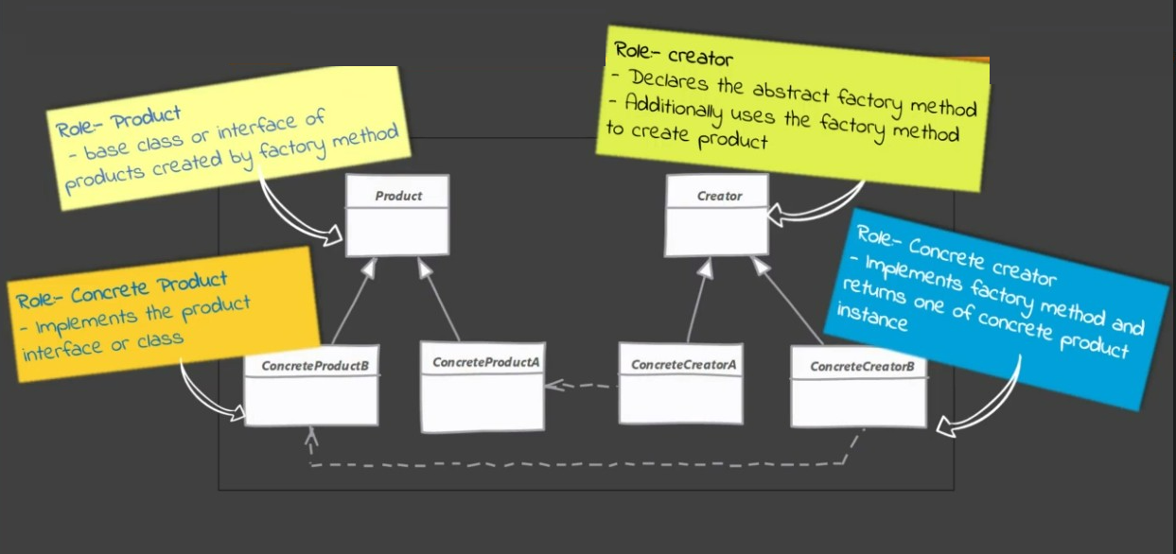
UML

Slide 32
Factory Method
Implement a Factory Method
We start by creating a class for our creator
Creator itself can be concreate if it can provide a default object or it can be abstract.
Implementations will override the method and return object.

Slide 33
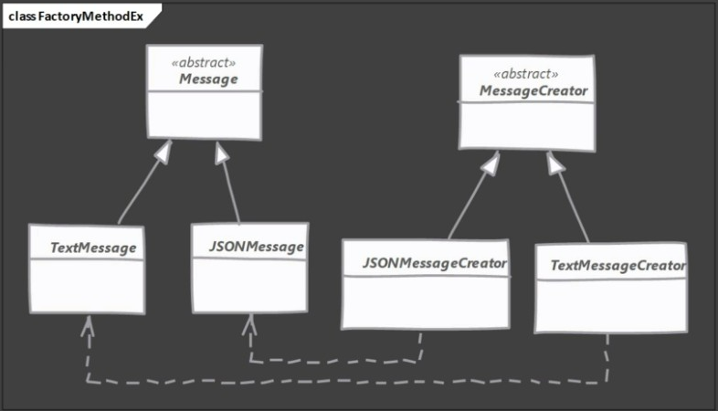
UML

Slide 34
Factory Method
Implementation Considerations
The creator can be a concrete class and provide a default implementation for the factory method. In such cases you will create some default object in base creator.
You can use the simple factory way of accepting additional arguments to choose between different object types. Subclasses the override factory method to selectively create different object for some criteria.

Slide 35
Factory Method
Design Considerations
Creator hierarchy in factory method pattern reflets the product hierarchy.
We typically end up with a concrete creator per object type.
Template method design pattern often makes use of factory method.
Another creational design pattern called ”abstract factory” makes use of factory method pattern.

Slide 36
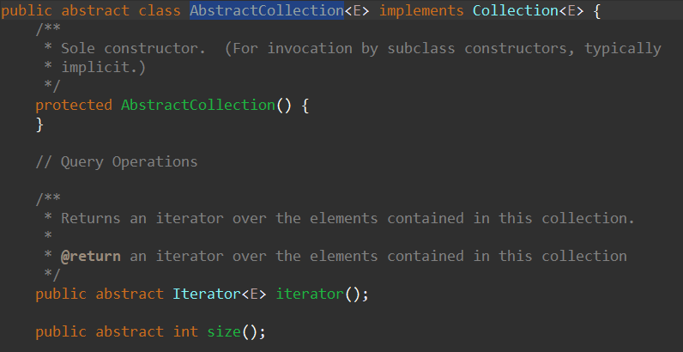
Factory Method
Examples of a Factory Method
The java.util.Collection(or java.util.AbstractCollection) has an abstract method called iterator(). This method is an example of factory method.

Slide 37
Factory Method
Pitfalls
More complex to implement. More classes are involved and need unit testing.
You have to start with Factory method design pattern from the beginning. It is not easy to refactor existing code into factory method pattern.
Sometimes this pattern forces you to subclass just to create appropriate instance.

Slide 38
Factory Method
Quiz
Which statement describles the difference between “Factory Method” and “Simple Factory” patterns?
Factory method uses inheritance to specialize object creation and simple factory don’t use inheritance.
Factory method is always static method in a final class while simple factory always uses non-static method.
To support creation of a new type of object we need to modify existing factory method pattern implementation while in simple factory pattern we add a new child class which creates the new object.
Factory Method pattern needs less number of classes to implement the Simple Factory method pattern when working with same product hierarchy.

Slide 39
Factory Method
Quiz
What is a drawback of factory method pattern?
We need to modify existing code of factory method pattern whenever a new product class is added to system
We often end up creating child classes just to instantiate a new object resulting in large number of classes which need unit testing.

Slide 40
Prototype
What is a Prototype?
We have a complex object that is costly to create. To create more instances of such class, We use and existing instance as our prototype.
Prototype will allow us to make copies of existing objects and save us from having to recreate objects from scratch.

Slide 41
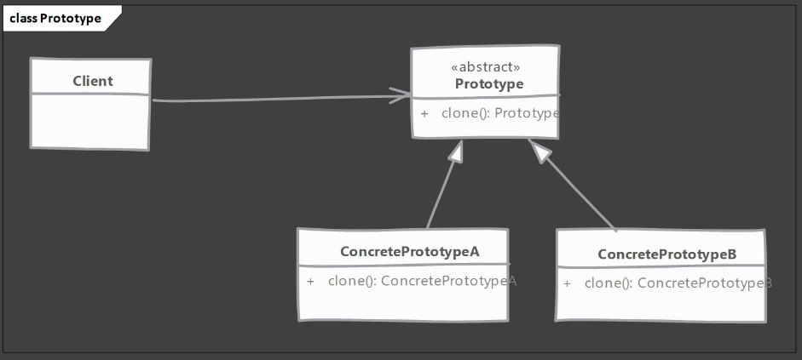
UML

Slide 42
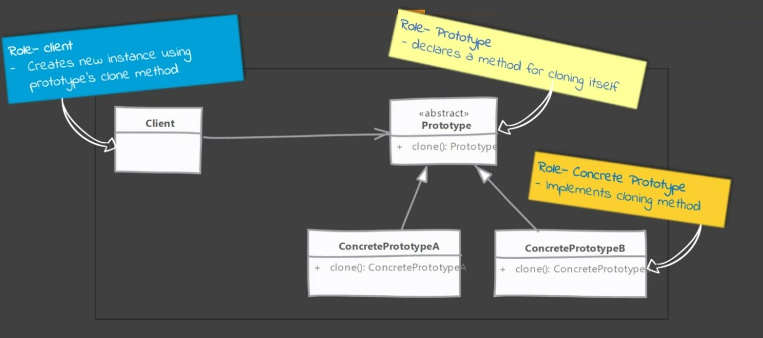
UML

Slide 43
Prototype
Implement a Prototype
We start by creating a class which will be a prototype
The class must implement cloneable interface
Class should override clone method and return copy of itself.
The method should declare CloneNotSupportedException in thows clause to give subclasses chance to decide on whether to support cloning.
Clone method implementation should consider the deep and shallow copy and choose whichever is applicable.

Slide 44
Prototype
Implementation Considerations
Pay attention to the deep copy and shallow copy of references.
Immutable fields on clones save the trouble of deep copy.
Make sure to reset the mutable state of objects before returning the prototype. It’s a good idea to implement this in method to allow subclasses to initialize themselves.
Clone() method is protected in Object class and must be overridden to public to be callable from outside the class.
Cloneable is a marker interface

Slide 45
Prototype
Design Considerations
Prototypes are useful when you have large objects where majority of state is unchanged between instances and you can easily identify that state.
Prototypes are useful when working with Composits and Decorator Patterns

Slide 46
Prototype
Actually the Object.clone() method is an example of a prototype!

Slide 47
Prototype
Prototype
Singleton
We return a copy of an instance, meaning we get a new instance
Some or even all of the state of instances created with prototypes can be different
We return same instance every time.
Since it’s the same object that is returned state is always the same.

Slide 48
Prototype
Pitfalls
Usability depends upon the number of properties in state that are immutable or can be shallow copied.
An object where state is comprised of large number of mutable objects is complicated to clone.
In java the default clone operation will only perform the shallow copy so if you need a deep copy you must implement it.
Subclasses may not be able to support clone and so the code becomes complicated as you have to code for situations where an implementations my not support clone.

Slide 49
Prototype
Quiz
Which of the following statement is true with regards to Prototype design pattern?
Prototype allows only one instance of the class to be created in entire application.
An object created with prototype pattern can never be garbage collected.
Prototype class must be declared as final to prevent inheritance.
Prototype pattern copies an existing object to create separate new object
Select the true statement from the following statements.
The clone() method provided in the Object class performs deep copy of the object.
The clone() method from Object needs to be overridden to make it public.
The clone() method is declared in Cloneable interface.
We can clone objects of any class in java.

Slide 50
Prototype
Quiz
Why we have to implement Cloneable interface in Prototype design pattern
It is not mandatory and just good practice to implement cloneable!
This interface adds the clone() method which is used to clone the object.
If cloneable interface is not implemented then clone method throws exception.
Cloneable needs to be implemented otherwise code dose not compile.

Slide 51
Singleton
What is a Singleton?
A singleton class has only one instance, accessible globally through a single point.
Main problem this pattern solves is to ensure that only a single instance of this class exists.
Any state you add in your singleton becomes apart of “global state” of your application.

Slide 52
Singleton
Implement a Singleton
Controlling instance creation
Class constructor(s) must be not be accessible globally
Subclassing /inheritance must not be allowed
Keeping track of instance
Class itself is a good place to track the instance
Giving access to the singleton instance
A public static method is good choice
Can expose instance as final public static fields but it wont work for all singleton implementations.

Slide 53
Singleton
Two options for implementing a singleton
Early initialization – Eager Singleton
Create singleton as soon as class is loaded
Lazy initialization – Lazy Singleton
Singleton is created when it is first required

Slide 54
Singleton
Implementation Considerations
Early/Eager initialization is the simplest and preferred way.
The classic singleton pattern implementation uses double check locking and volatile field.
The lazy initialization holder idiom provides best of both worlds, you don’t deal with synchronization issues directly and is easy to implement.

Slide 55
Singleton
Design Considerations
Singleton creation does not need any parameters. If you find yourself in need of support for constructor arguments, you need a simple factory or factory method pattern instead.

Slide 56
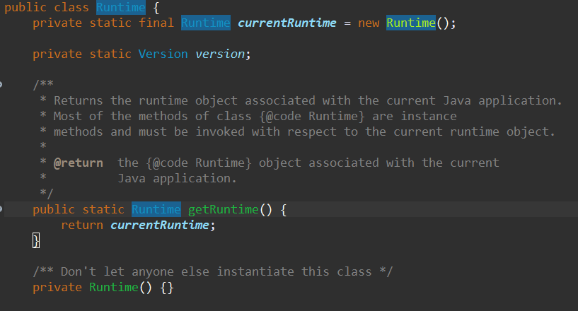
Singleton
Example of a Singleton Pattern
Java.lang.Runtime class in standard Java API is a singleton.

Slide 57
Singleton
Singleton pattern can deceive you about true dependencies! Since you are globally accessible its easy to miss dependencies.
They are hard to unit test. You cannot easily mock the instance that is returned.
Most common way to implement singletons in Java is through static variables and they are held per class loader and not per JVM. So they may not be truly singleton.

Slide 58
Singleton
Quiz
What is Eager singleton?
In eager singleton implementation the singleton instance is created as soon the singleton class is referenced.
In eager singleton implementation the singleton instance is created when some code calls getInstance() method.
In eager singleton implementation the singleton instance is created as soon as JVM process starts.
In eager singleton implementation the singleton instance is created when an instance method is called on singleton reference.

Slide 59
Singleton
Quiz
What is double check locking that is used by lazy singleton implementation?
Double check locking means we use two synchronization blocks, one inside another. We also use volatile keyword to declare reference.
We check twice for the singleton reference to be null, once before synchronization block and then inside the synchronization block and we have to make sure the reference is volatile.
Two separate locks are declared in the singleton class and we have to ensure both locks are locked to create singleton instance.
We call getInstacen() method twice and check the return value.

Slide 60
Structural Design Pattern
Adapter
Bridge
Decorator
Composite
Façade
Flyweight
Proxy

Slide 61
Adapter(aka Wrapper)
What is Adapter?
We have an existing object which provides the functionality that client needs. But client cant use this object because it expects and object with different interface.
Using adapter design pattern we make this existing object work with client by adapting the object to client’s expected interface.
This pattern is also called as wrapper as its ”wraps” existing object.

Slide 62
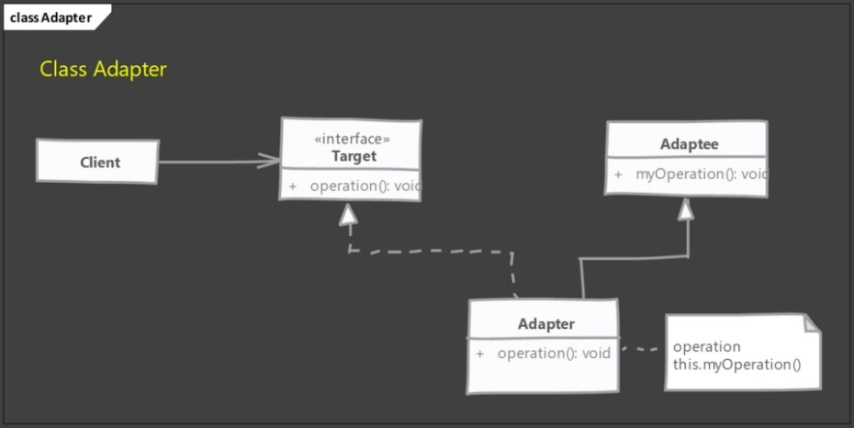
UML – Class Adapter

Slide 63
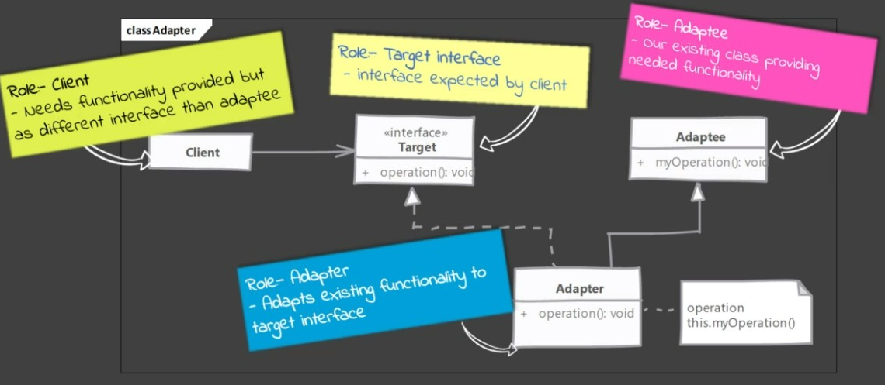
UML – Class Adapter

Slide 64
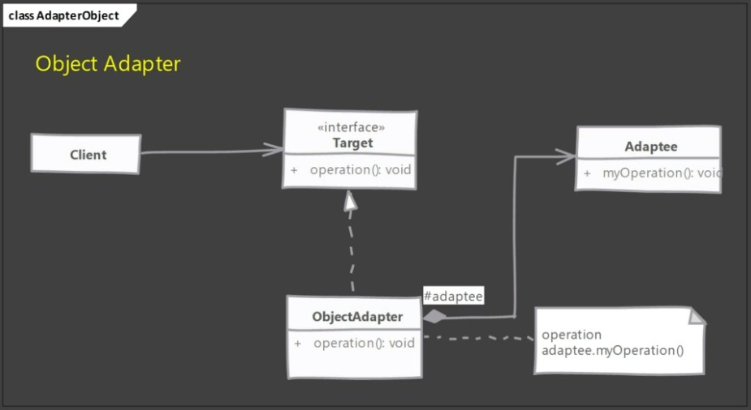
UML – Object Adapter

Slide 65
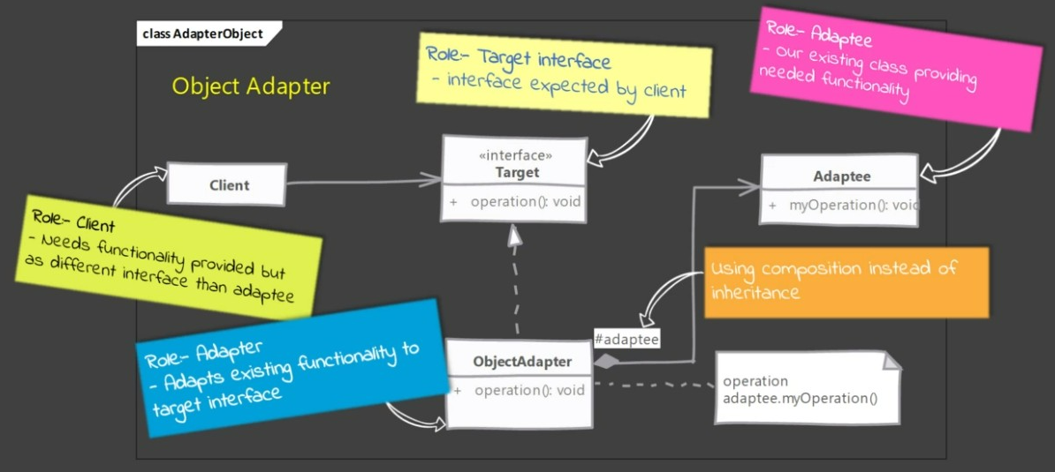
UML – Object Adapter

Slide 66
Adapter
Implement an Adapter
We start by creating a class for Adapter
Adapter must implement the interface expected by client.
First we are going to try out a class adapter by also extending from our existing class.
In the class adapter implementation we are simply going to forward the method to another method inherited from adaptee.
Next for object adapter , we are only going to implement target interface and accept adaptee as constructor argument in adapter i.e. make use of composition.
An object adapter should take adaptee as an argument in constructor or as less preferred solution, you can instantiate it in the constructor thus tightly coupling with a specific adaptee

Slide 67
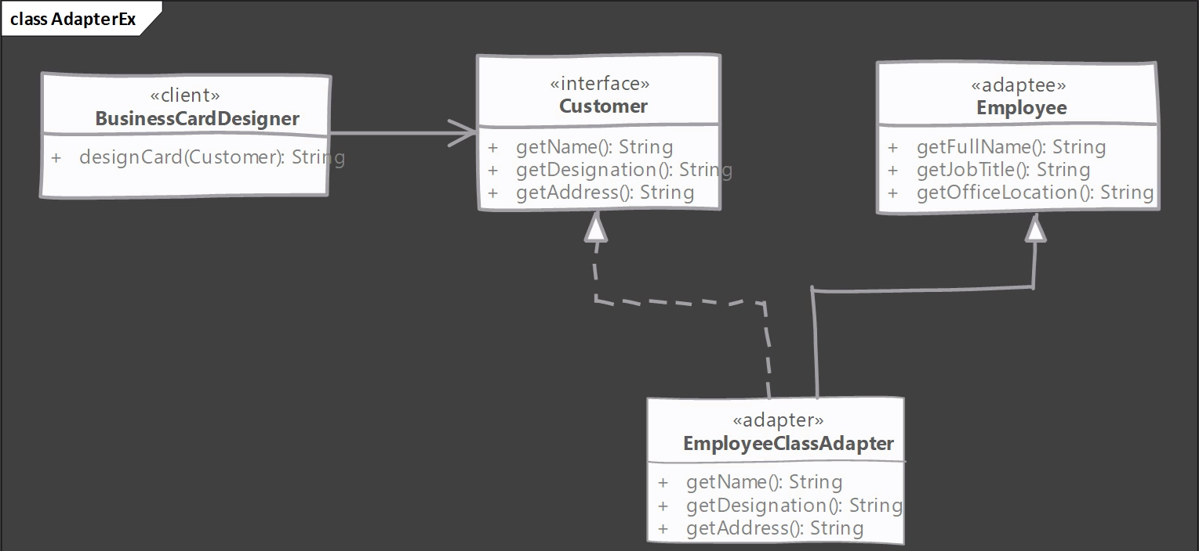
Example UML – Class Adapter

Slide 68
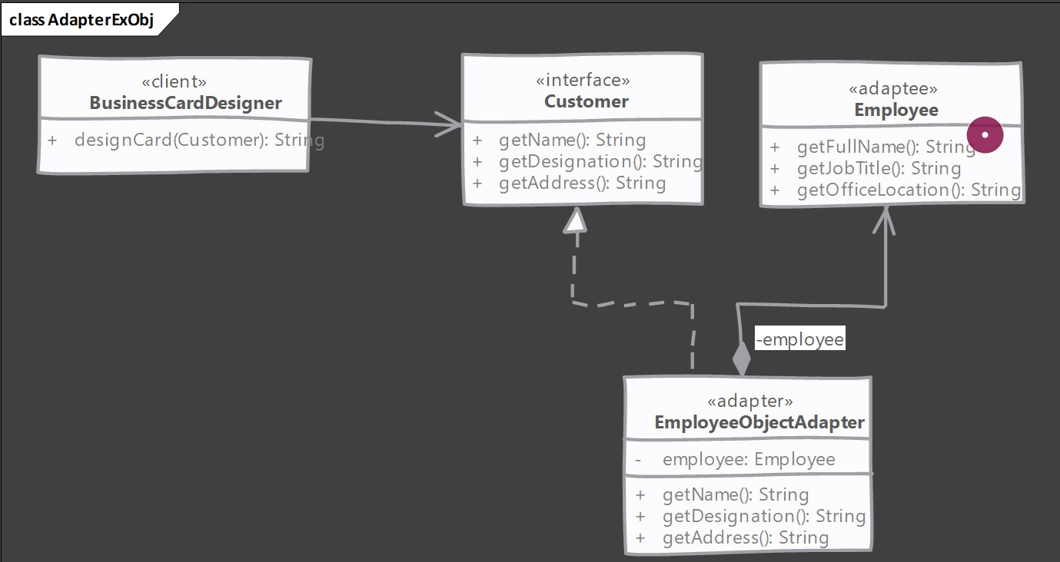
Example : UML (Object Adapter)

Slide 69
Adapter
Implementation Considerations
How much work the adapter does depends upon the differences between target interface and object being adapted.
If method arguments are same or similar adapter has very less work to do.

Slide 70
Adapter
In java a “class adapter” may not be possible if both target and adaptee are concrete classes. In such cases the object adapter is the only solution. Also since there is not private inheritance in java its better to stick with object adapter.
A class adapter is also called as a two way adapter, since it can stand in for both the target interface and for the adaptee. That is we can use object of adapter where either target interface is expected as well as and adaptee object is expected.

Slide 71
Adapter
Examples of an Adapter
The java.io.InputStreamReader and OutputStreamWriter classes

Slide 72
Adapter
Pitfalls
Using target interface and adaptee class to extend our adapter we can create a class adapter in java.
However it create an object which exposes unrelated methods in parts of your code, polluting it.
Avoid class adapters.

Slide 73
Adapter
Quiz
Which one of the following scenarios is most suitable for using Adapter design pattern?
We want to add new functionality to a class without modifying original code.
We have existing object the provide needed functionality but client code needs expects different interface.
We want to hide our real object for client.
When we want to intercept method calls for logging and authantication.

Slide 74
Adapter
Quiz
Which one of the following is not NOT a type of adapter in Adapter Design Pattern?
Class Adapter
Java Adapter
Object Adapter

Slide 75
Decorator
What is Decorator?
When we want to enhance behaviour of our existing object dynamically as and when required then we can use decorator design pattern.
Decorator wraps an object within itself and provides same interface as the wrapped object. So the client of original object doesn’t need to change.
A decorator provides alternative to subclassing for extending functionality of existing classes.

Slide 76
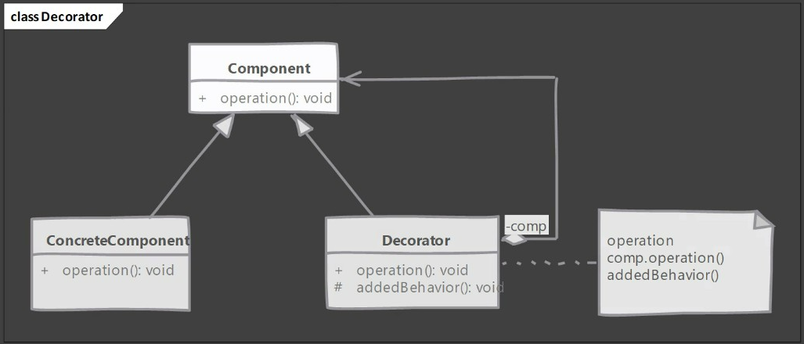
Decorator

Slide 77
Decorator
Implement a Decorator
We start with our component
Component defines interface needed or already used by client.
Concrete component implements the component.
We define our decorator. Decorator implements components and also needs reference to concrete component.
In decorator methods we provide additional behaviour on top the provided by concrete component instance.
Decorator can be abstract as well & depend on subclasses to provide functionality.

Slide 78
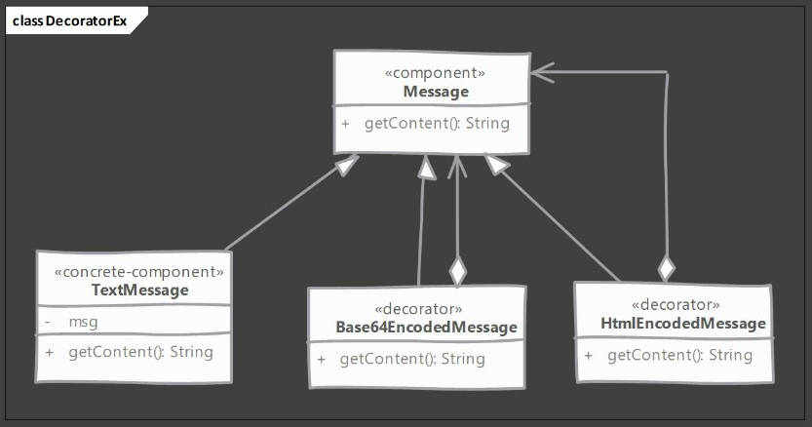
Decorator

Slide 79
Decorator
Implementation Considerations
Since we have decorators and concrete class extending from common component , avoid large state in this base class as decorators may not need all that state.
Pay attention to equals and hashCode methods of decorator. When using decorators, you have to decide if decorated object is equal to same instance without decorator.
Decorator supports recursive composition and so this pattern lends itself to creation of lots of small objects that add “just a little bit” functionality. Code using these objects becomes difficult to debug.

Slide 80
Decorator
Design Considerations
Decorators are more flexible and powerful than inheritance.
Inheritance is static by definition but decorators allow you to dynamically compose behaviour using objects at runtime.
Decorators should act like additional skin over your object. They should add helpful small behaviours to objects original behaviour. Do not change the meaning of operations.

Slide 81
Decorator
Example of Decorator
Classes in java I.O packages are great examples of decorator pattern.
For example java.io.BufferedOutputStream class decorates any java.io.OutputStream object and adds buffering to file writing operations.

Slide 82
Decorator
Pitfalls
Often result in large number of classes being added to system, Where each class adds small amount of functionality.
Sometimes new comers will start using it as a replacement of inheritance in every scenario. Think of decorators as a thin skin existing objects.

Slide 83
Decorator
Quiz
What is the fundamental purpose behind using Decorator design pattern?
It allows us to adapt existing object to a new interface expected by the client code.
Add new functionality on top of what is provided by existing object.
To completely change the functionality of existing object.
Provide decorative formatting to objects textual representation.
Decorators allows recursive composition. What exactly dose “Recursive composition” means in this context?
It means , a decorator can be composed with/wrap another decorator written for same object which in turn can also wrap another decorator and so on.
All decorator methods can be called recursively.
The decorators call recursive methods on the original object.
Its simply a single decorator containing the original object via composition. We cant compose a decorator with another decorator.

Slide 84
Decorator
Quiz
Select the true/correct statements from below.
A decorator changes the interface of the object which it decorates.
A single decorator instead can be decorate multiple objects at the same time.
A decorator cannot be used in place of original object in the client code.
A decorator always inherits from the same interface/class from which object it decorates inherits.

Slide 85
Proxy
What is a Proxy?
We need to provide a placeholder or surrogate to another object.
Proxy acts on behalf of the object and is used for lots of rezones some of the main reasons are:
Protection Proxy – Control access to original object’s operations
Remote Proxy – Provides a local representation of a remote object
Virtual Proxy – Delays construction of original object until absolutely necessary
Client is unaware of existence of proxy. Proxy performs its work transparently.
Lazy loading of collections by hibernate , AOP based method level security. RMI/Web Service stubs are examples of real life proxy usage.

Slide 86
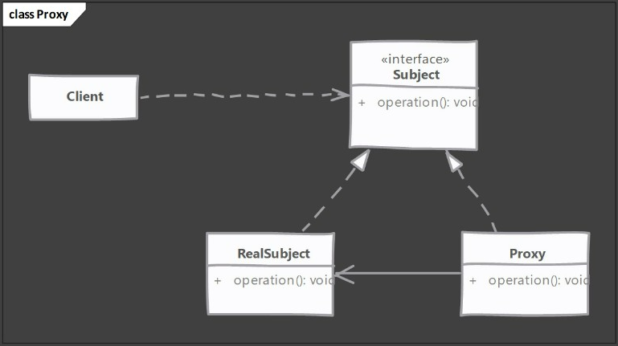
Proxy

Slide 87
Proxy
Implement a Proxy
We start by implementing proxy
Proxy must implement same interface as the real subject
We can either create actual object later when required or ask for one in constructor.
In method implementation of proxy we implement proxy functionality before delegating to real object.
How to provide client with proxies instance is decided by application. We can provide a factory or compose client code with proxies instance.
What we are implementing above is also called as static proxy. Java also provides dynamic proxies.

Slide 88
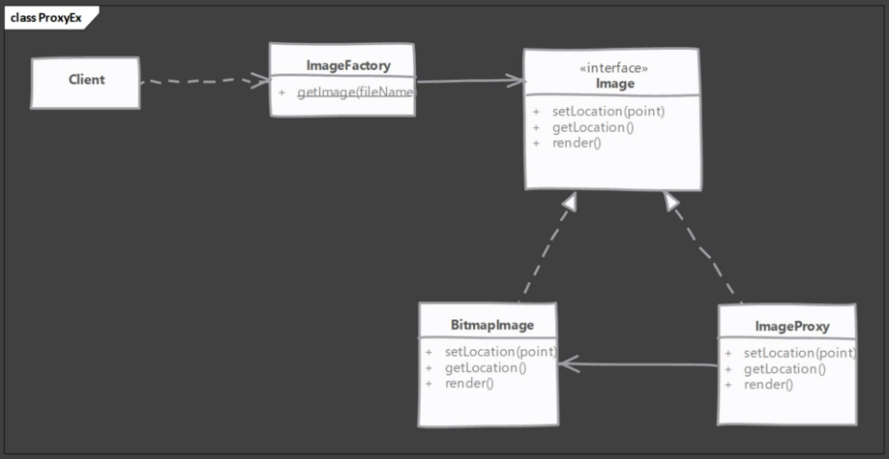
Proxy

Slide 89
Proxy
Implementation Considerations
How proxy gets hold of the real object is depends on what purpose proxy servers.
For creation on demand type of proxies, actual object is created only when proxy cant handle client request.
Proxy itself can maintain/cache some state on behalf of real object in creation demand use cases.

Slide 90
Proxy
Design Considerations
Proxies typically do not need to know about the actual concrete implementation of real object.
Proxies are great for implementing security or as stan-in of real objects which may be a costly object that you want to defer loading.
Proxies also make working with remote services/API easy by representing them as regular objects and possibly handling network communication behind the scene.

Slide 91
Proxy
Examples of Proxy
Hibernates uses a proxy to load collections of values types. If you have a relationship in entity class mapped as a collection, marked as candidate for lazy loading the Hibernate will provide a proxy in its place.

Slide 92
Proxy
Pitfalls
Proxies look quite similar to other patterns like decorator and adapter patterns. It can be confusing to figure it out from the code alone for someone not familiar with all these patterns.

Slide 93
Proxy
Quiz
Which of the following is NOT a correct use of Proxy Pattern?
Controlling access to methods of real object.
Providing local representation of remote objects and services.
Delaying construction of real object until needed.
Providing new instances via cloning.
Which of the following is an example of usage of Proxy design pattern?
Storing objects in an instance of java.util.ArrayList class.
The java.lang.Runtime class implementation.
Lazy loading of collections by Hibernate.
The lock interface and its implementations in java

Slide 94
Behavioural Design Patterns
Chain of Responsibility
Command
Interpreter
Mediator
Iterator
Memento
Observer
State
Strategy
Template Method
Visitor
Null Object

Slide 95
Chain of Responsibility
What is Chain of Responsibility?
We need to avoid coupling the code which sends request to the code which handles that request.
Typically the code which wants some request handled calls exact method on an exact object to process it, thus the tight coupling.
Chain of responsibility solve this problem by giving more than one object, chance to process the request.
We create objects which are chained together by one object knowing reference of object which is next in chain. We give request to first object in chain, if it cant handle that it simply passes the request down the chain.

Slide 96
Chain of Responsibility
Implement Chain of Responsibility
We start by defining handler interface/abstract class
Handler must define a method to accept incoming request
Handler can define method to access successor in chain. If its an abstract class then we can even maintain successor
Next we implement handler in one or more concrete handlers. Concrete handler should check if it can handle the request. If not then it should pass request to next handler.
We have to create our chain of objects next. We can do it in client. Typically in real world this job will be done by some framework or initialization code written by you.

Slide 97
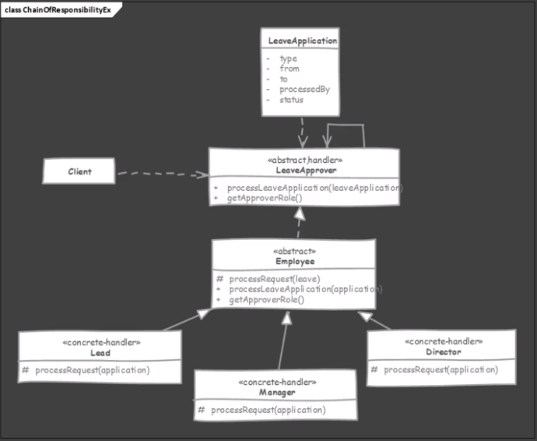
UML

Slide 98
Chain of Responsibility
Implementation Considerations
Prefer defining handler as interface as it allows you to implement chain of responsibility without worrying about single inheritance rule in java.
Handlers can allow the request to propagate even if they handle the request. Servlet filter chains allow request to flow to next filter even if they perform some action in request.

Slide 99
Chain of Responsibility
Example of a Chain of responsibility
Probably the best example of chain of responsibility is servlet filters.
Each filter gets a chance to handle incoming request and passes it down to the chain once its work is done.

Slide 100
Chain of Responsibility
Pitfalls
There is no guarantee provided in the pattern that a request will be handled.
Request can traverse whole chain and fall off at the other end without ever being processed and we wont know it.
It is easy to misconfigure the chain when we care connecting successors.
There is nothing in the pattern that will let us know of any such problems.

Slide 101
Chain of Responsibility
Quiz
In Chain of Responsibility design pattern how is the request object passed from one handler to another?
Client code knows about all handlers in advance and calls the one by one, passing the request object.
Request object is actually never passed on to more than one handler.
Java runtime takes care of calling handlers.
Each handler knows the next one and passes request object by calling the next handler.

Slide 102
Chain of Responsibility
Quiz
Which one of the following is drawback of Chain of Responsibility design pattern?
A request may go unprocessed and client may not know about it.
There is a tight coupling between client code which wants a request processed and all handler classes.
Handler classes need to process each and every request object and take some action thus they are difficult to implement.

Slide 103
Observer
What is Observer?
Using observer design pattern we can notify multiple objects whenever an object changes state.
This design pattern is also called as publisher-subscriber.
We are defining one-to-many dependency between objects, where many objects are listening for state change of a single object without tightly coupling all if them together.
This pattern is often implemented where listener only gets notifications that something has changed in objects state.
Listeners query back to find out more information if needed. This makes it more generic as different listeners may be interested in different states.

Slide 104
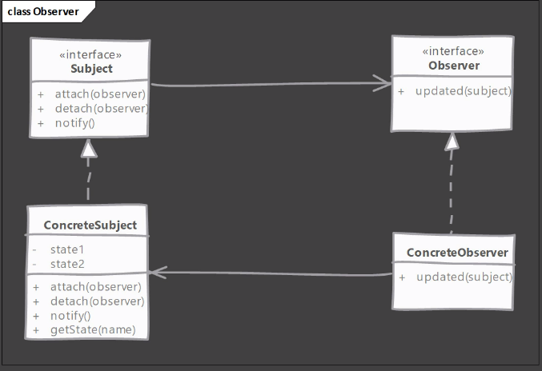
UML

Slide 105
Observer
Implement Observer
We define an interface for observer.
Observer is usually a very simple interface and defines a method used by “subject” to notify about state change.
Subject can be an interface if we are expecting our observers to listen to multiple object or else subject can be any concrete class
Implementing subject means taking care of handling attach , detach of observers , notifying all registered observers and providing methods to provide state information requested by observers.

Slide 106
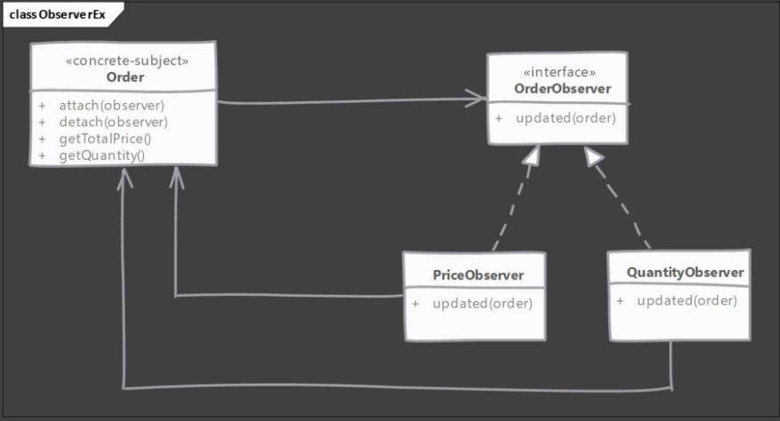
UML

Slide 107
Observer
Implementation Considerations
In some rare scenarios you may end with a circular update loop. i.e. an update to observables state results in notification being sent to a observer which then takes some action and that action results in state change of our observable , triggering another notification and so on.
An observer object can listen for changes in multiple objects. It becomes quite easy to identify originator for the notification if subjects pass a reference to themselves in notification to observer

Slide 108
Observer
Examples of Observer
Observer is such a useful pattern that Java comes with support for this in java class library.
We have java.util.Observer interface and java.util.Observable class shipped with JDK.

Slide 109
Observer
Pitfalls
Every setter method triggering updated may be too much if we have client setting properties one after another on our observable.
Also each update becomes expensive as no of observers increase and we have on or more slow observes in the list.
If observers call back the subject to find what changed then this can add up to quite a bit of overhead.

Slide 110
Observer
Quiz
Which of the following statements defines ideal scenario where Observer design pattern can be used?
Couple of objects are communicating between themselves and we want to encapsulate this communication.
We have a request object which needs to be processed but client does not know and care which object is actually processing it.
An object state needs to stored whenever it changes and we need another “sealed ” object to store the current state.
One or more objects are interested in knowing when specific object changes state.

Slide 111
Observer
Quiz
Select true statement from option below
Observable is also called as a “subject” and it notifies “listeners”
Observer is also called as a “subject” and it notifies “listeners”

